Slide 1

8th Grade Math: Pre-Algebra
Unit 2, Lesson 7 Plotting, Ordering, and Comparing Real Numbers Volume 1, pg. 72

Slide 2


Benchmark
MA.8.NSO.1.2
Plot, order, and compare rational and irrational numbers, represented in various forms.
volume 1, pg. 72

Slide 3
Integrated Mathematical Thinking and Reasoning Standards
MA.K12.MTR.1.1 Actively participate in effortful learning both individually and collectively.
MA.K12.MTR.3.1 Complete tasks with mathematical fluency.
MA.K12.MTR.4.1 Engage in discussions that reflect on the mathematical thinking of self and others.
volume 1, pg. 72

Slide 4

Learning Targets
I can compare rational and irrational values.
I can order rational and irrational values.
I can plot rational and irrational numbers on a number line.
volume 1, pg. 72

Slide 5

Warm-Up
volume 1, pg. 73

Slide 6
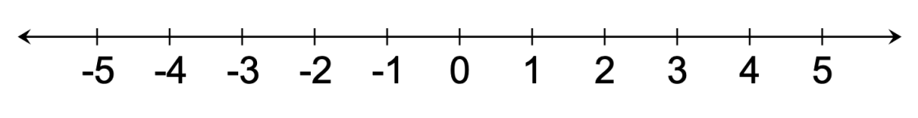
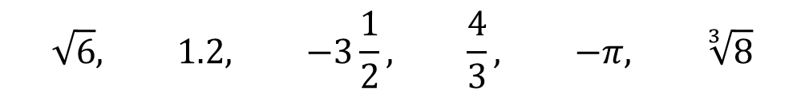
2.7.1 Warm-Up: Bell Work
Six real numbers are shown.
Circle all numbers that are irrational.
Order all the values from greatest to least.
Plot and label each number on the number line.
$$\sqrt{6}, 1.2, −3\frac{1}{2}, \frac{4}{3}, −π, \sqrt[3]{8}$$
volume 1, pg. 73

Slide 7

Activity
volume 1, pg. 73

Slide 8

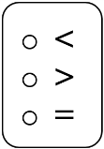
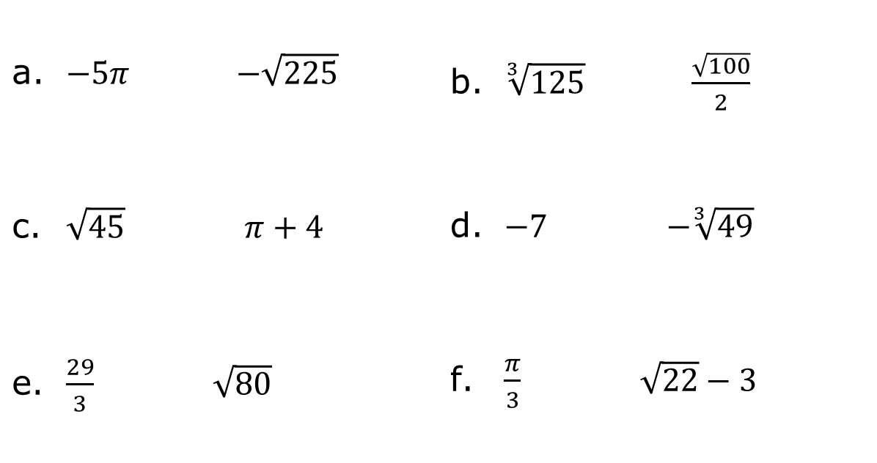
2.7.2 Activity: Station 1 – Comparing and Ordering
Compare each pair of expressions using the symbols $<$, $>$, or $=$.
$−5π$ $−\sqrt{225}$ | $\sqrt[3]{125}$ $\frac{\sqrt{100}}{2}$
$\sqrt{45}$ $π+4$ | $−7$ $−\sqrt[3]{49}$
$\frac{29}{3}$ $\sqrt{80}$ | $\frac{π}{3}$ $\sqrt{22}−3$
volume 1, pg. 73

Slide 9
Choose one pair of expressions from the previous question that were not equivalent.
Circle the pair of expressions.
Explain how you determined which value was greater.
volume 1, pg. 73

Slide 10

Order each set of numbers from least to greatest.
$\sqrt{34}$, $π+2, 5\frac{1}{2}$
$−\sqrt[3]{60}, −\frac{18}{4}, −π$
volume 1, pg. 74

Slide 11
Activity
volume 1, pg. 74

Slide 12
2.7.3 Activity: Station 2 – Plotting Rational and Irrational Numbers on a Number Line
Five expressions are shown.
Write each expression under the appropriate description in the table.
$$\sqrt{150}$$ | $$−π+15$$ | $$10.2$$ | $$11\frac{1}{3}$$ | $$\sqrt[3]{64}+8$$
Includes Only Rational Numbers | Includes an Irrational Number
volume 1, pg. 74

Slide 13
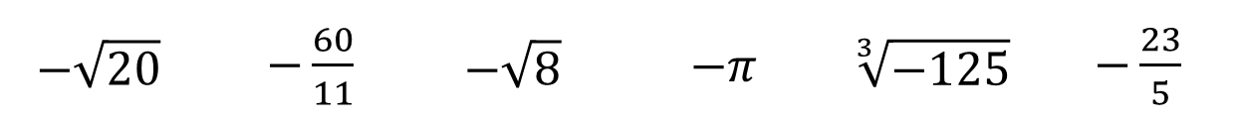
Plot and label each number on the number line.
Six expressions are shown.
Plot and label the location of each expression on the number line.
$$−\sqrt{20}$$ | $−\frac{60}{11}$ | $$−\sqrt{8}$$ | $−π$ | $$\sqrt[3]{−125}$$ | $−\frac{23}{5}$
volume 1, pg. 75

Slide 14
Activity
volume 1, pg. 75

Slide 15

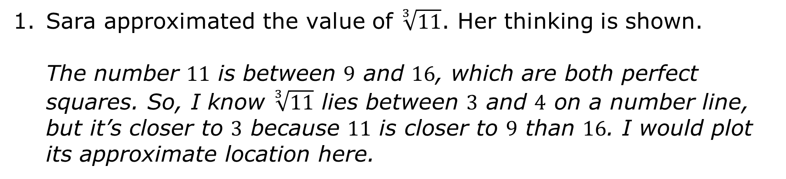
2.7.4 Activity: Station 3 – Error Analysis
Sara approximated the value of $\sqrt[3]{11}$. Her thinking is shown.
The number $11$ is between $9$ and $16$, which are both perfect squares. So, I know $\sqrt[3]{11}$ lies between $3$ and $4$ on a number line, but it’s closer to $3$ because $11$ is closer to $9$ than $16$. I would plot its approximate location here.
$$\sqrt[3]{11}$$
volume 1, pg. 75

Slide 16

Discuss Sara’s thinking with your partner. Then, complete the table.
Plot and label the correct approximate value of $\sqrt[3]{11}$ on the number line.
What is correct in Sara’s thinking? | What error(s) did Sara make?
volume 1, pg. 75

Slide 17
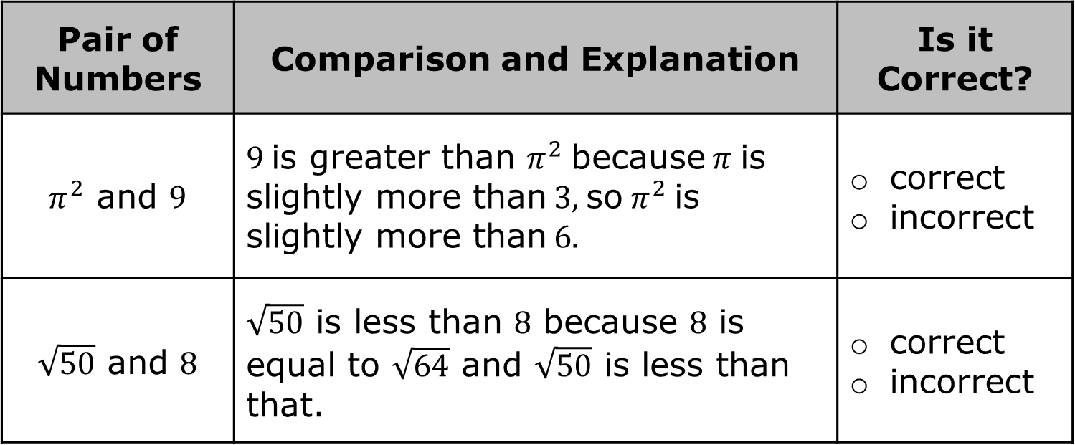
For each pair of numbers, an explanation comparing the values is provided.
Determine whether each explanation is correct or incorrect.
Pair of Numbers | Comparison and Explanation | Is it Correct?
$π^{2}$ and $9$ | $9$ is greater than $π^{2}$ because $π$ is slightly more than $3$, so $π^{2}$ is slightly more than $6$. | correct incorrect
$\sqrt{50}$ and $8$ | $\sqrt{50}$ is less than $8$ because $8$ is equal to $\sqrt{64}$ and $\sqrt{50}$ is less than that. | correct incorrect
volume 1, pg. 76

Slide 18
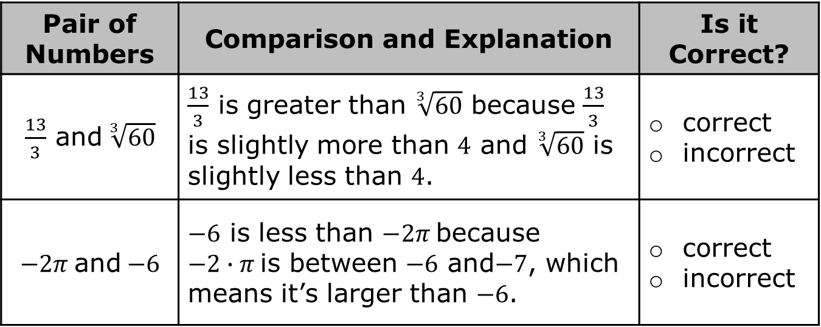
Pair of Numbers | Comparison and Explanation | Is it Correct?
$\frac{13}{3}$ and $\sqrt[3]{60}$ | $\frac{13}{3}$ is greater than $\sqrt[3]{60}$ because $\frac{13}{3}$ is slightly more than $4$ and $\sqrt[3]{60}$ is slightly less than $4$. | correct incorrect
$−2π$ and $−6$ | $−6$ is less than $−2π$ because $−2∙π$ is between $−6$ and$−7$, which means it’s larger than $−6$. | correct incorrect
Two of the explanations above are incorrect. Write the correct explanation for each of them by completing the sentence stems.
______ is greater than ______ because ...
______ is less than ______ because ...
volume 1, pg. 76

Slide 19

Wrap-Up
volume 1, pg. 77

Slide 20
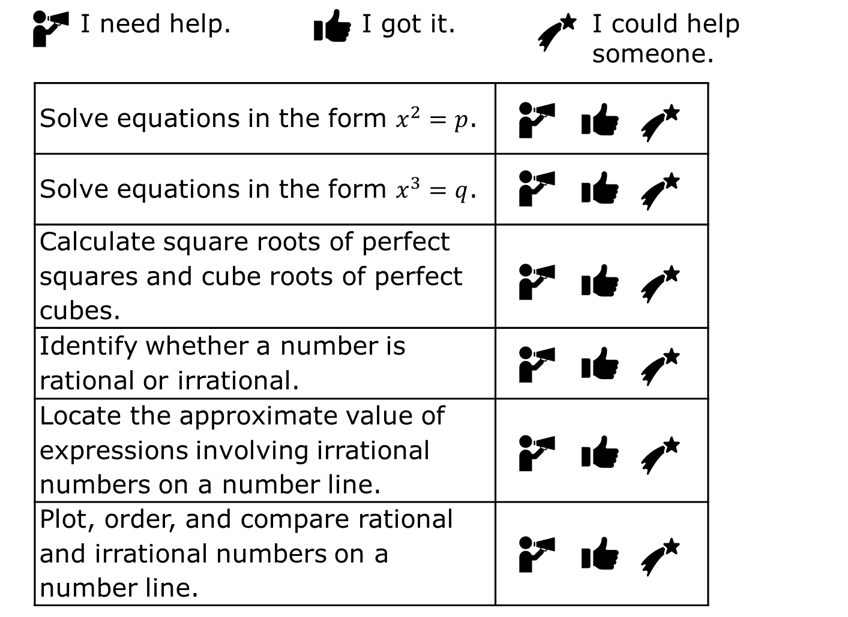
2.7.5 Wrap-Up: Reflection
Circle the icon that best describes your understanding of each concept learned in this unit.
volume 1, pg. 77

